Slide 1
Employee Attrition Analysis

Slide 2
Introduction
XYZ company which was established a few years back is facing around a 15% attrition rate for a couple of years. And it's majorly affecting the company in many aspects. In order to understand why employees are leaving the company and reduce the attrition rate XYZ company has approached an HR analytics consultancy for analyzing the data they have.
You are playing the HR analyst role in this project and building a dashboard which can help the organization in making data-driven decisions.

Slide 3
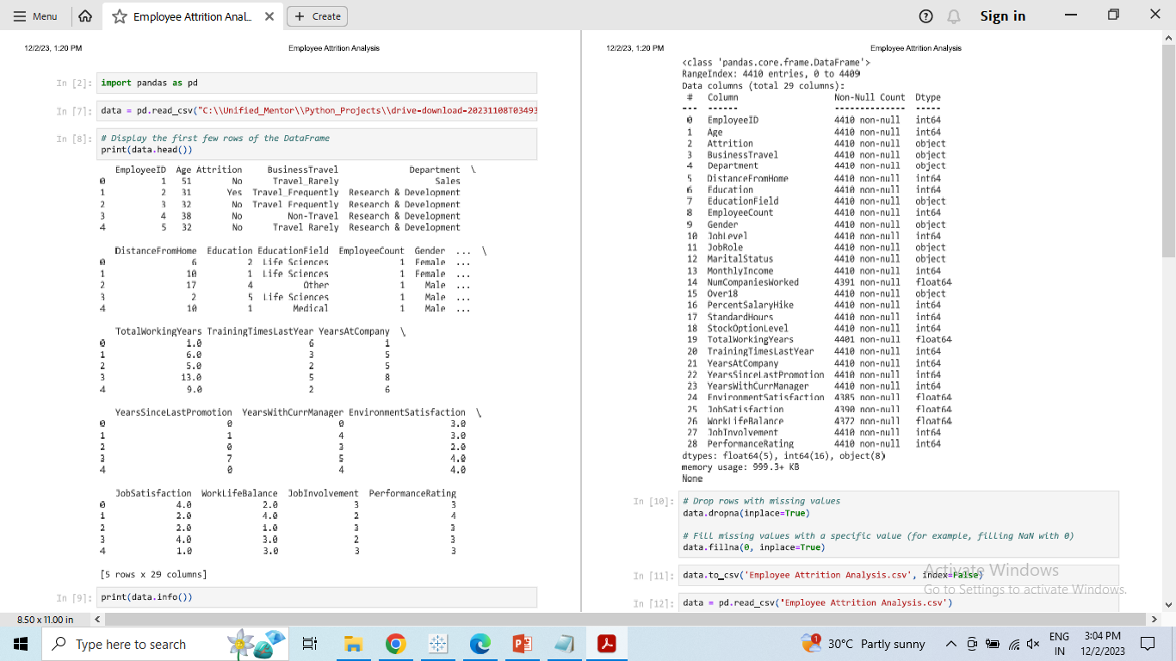
Details of Data

Slide 4
Main KPIs
Attrition by Gender
Department wise Attrition
No. of Employee by Age Group
Job Satisfaction Rating
Education field wise Attrition
Attrition Rate by Gender for different Age group

Slide 5
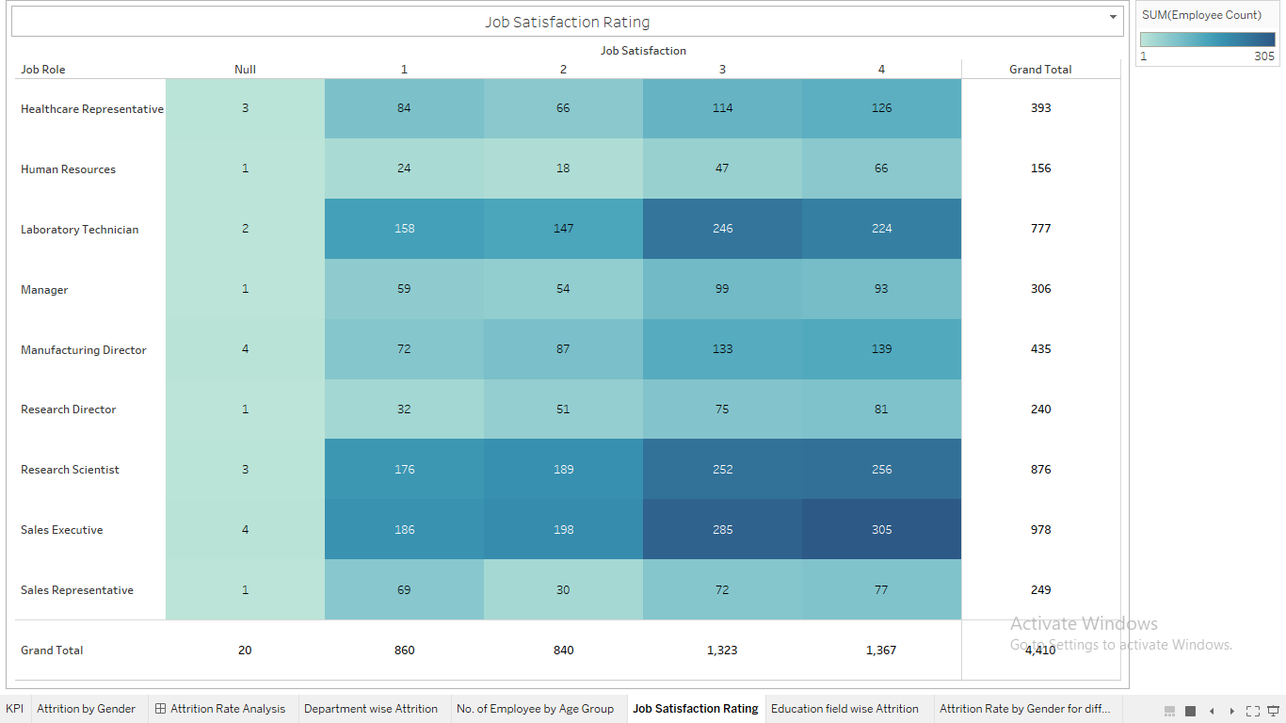
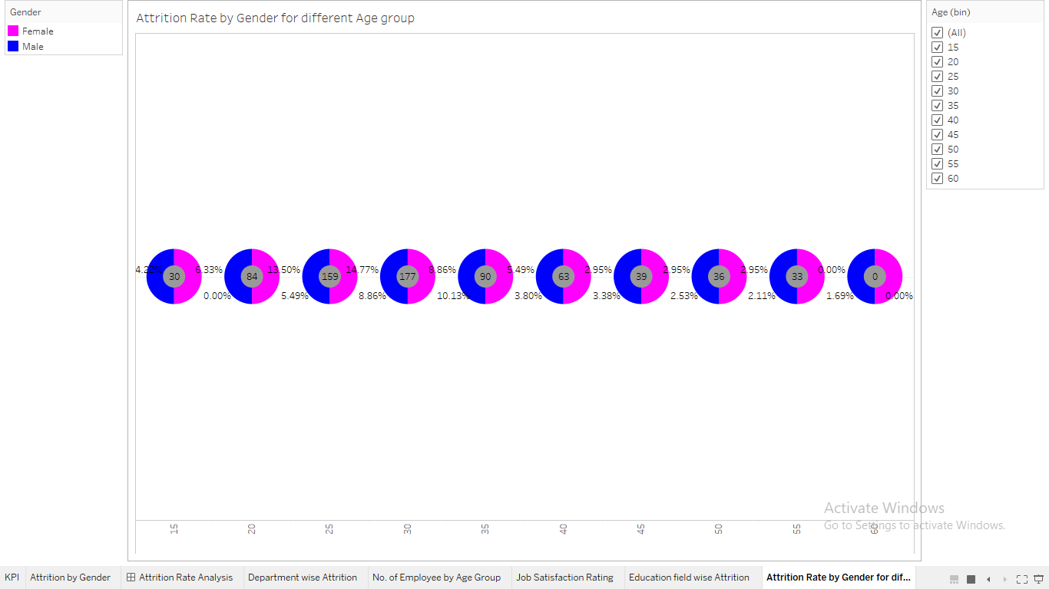
Dashboard - Employee Attrition Analysis https://public.tableau.com/app/profile/kulbhushan.huparikar/viz/EmployeeAttritionAnalysis_17014986647810/AttritionRateAnalysis?publish=yes

Slide 6
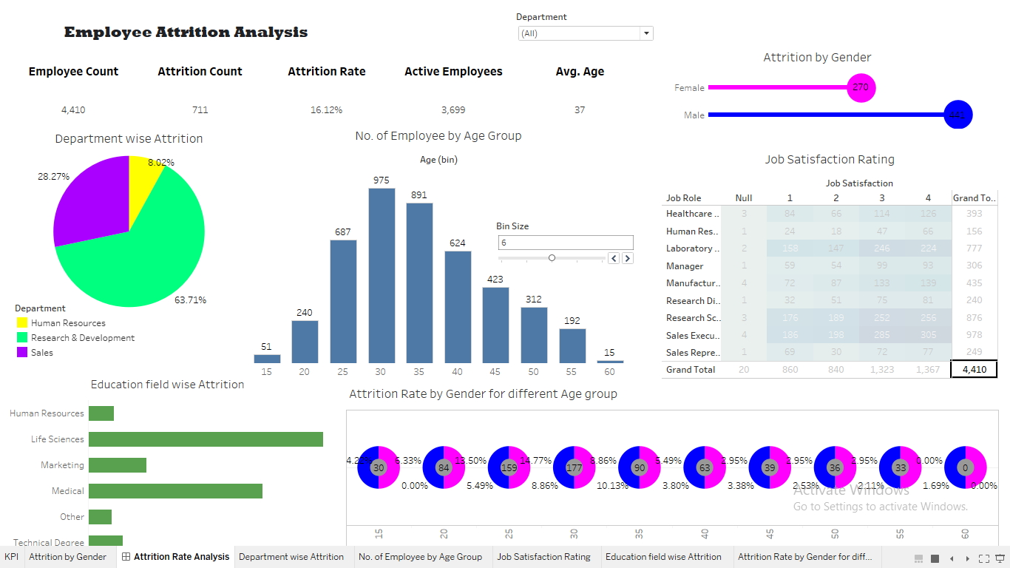

Slide 7
Thank you

